Slide 1

TRAVEL AND TOURISM MANAGEMENT SYSTEM
Evaluated By:
Dr.Cynthia
Presented by:
ALWIN TOMY - 2347207
PAVITHARANI G P - 2347244
VISHNU SWAROOP P S - 2347265

Slide 2
ABSTRACT
Our Travel and Tourism Management System is a comprehensive SWING-based web application designed to automate and streamline travel-related processes.
This project highlights the hardware and software requirement.The application also serves as a valuable resource for obtaining details about travel agencies.
In the rapidly evolving landscape of the travel and tourism industry, the need for efficient and streamlined management systems has become increasingly apparent. The Travel and Tourism Management System project aims to address this demand by developing a comprehensive application that automates various processes and activities related to travel. This system is designed to empower users to perform a wide array of operations with ease, ranging from accessing destination information to managing personal travel details.

Slide 3

CONTENTS
Introduction
Hardware Requirements
Software Requirements
Project Description
Conclusion
ScreenShots

Slide 4
INTRODUCTION
The Travel and Tourism Management System project is designed to revolutionize travel operations by introducing a comprehensive and user-friendly application. With a primary focus on user convenience, the system incorporates a robust user profile management module, empowering individuals to add, update, and delete their personal information.
Users can seamlessly explore and book travel packages and hotels, simplifying the travel planning process. The application serves as a centralized hub for accessing vital travel information, aiding users in tracking their tours effortlessly. Furthermore, it offers valuable insights into various travel agencies. The inclusion of a secure payment gateway ensures a safe and efficient transaction process, enhancing the overall travel experience.

Slide 5
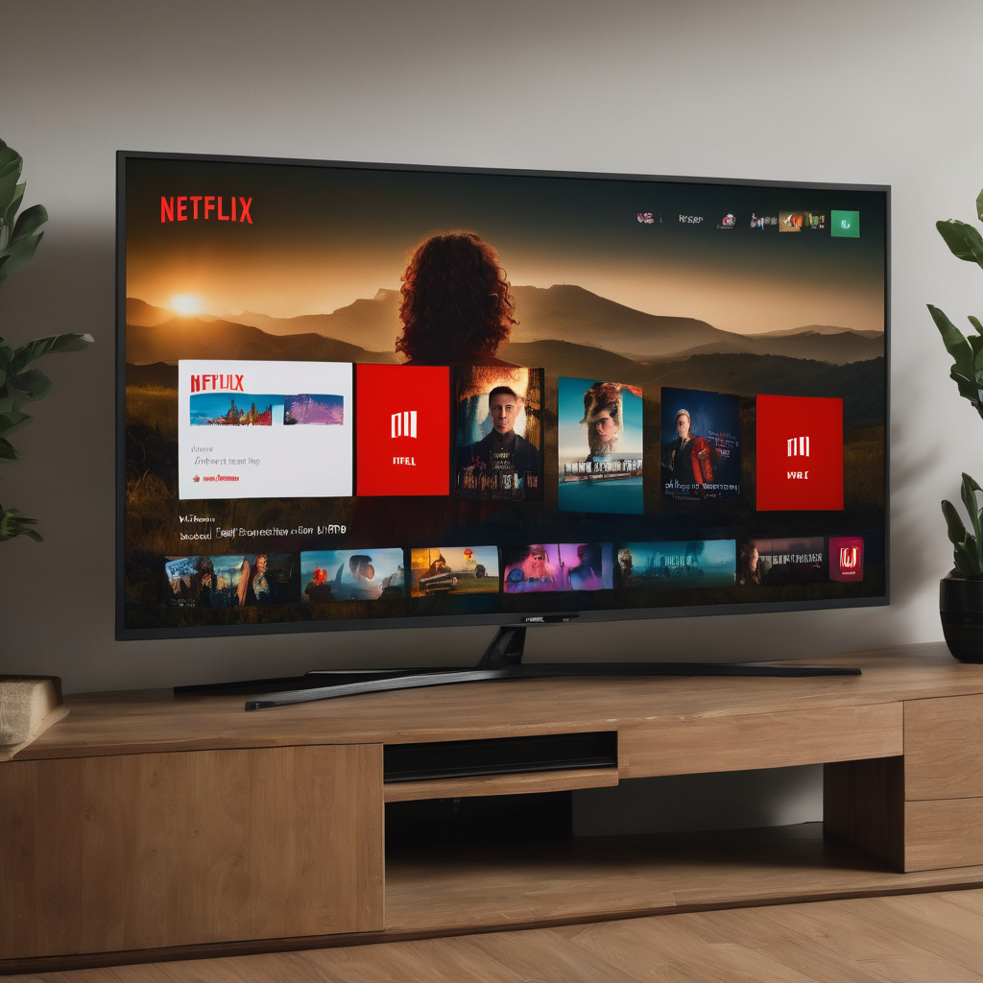
HARDWARE REQUIREMENTS
Monitor Type : Any modern monitor with a minimum resolution of 1280x800.
Processor : Intel dual-core processor and above.
RAM Size : 4 GB or more .
Clock Speed : 2.0 GHz or higher.
Hard Disk Capacity : 256 GB or more.

Slide 6
SOFTWARE REQUIREMENTS
Operating System : Windows 10, macOS, Linux.
Code Editor : Visual Studio Code or your preferred code editor.
Node.js : Install Node.js with npm for managing dependencies and running JavaScript.
ReactJS : Create your Netflix Clone project using ReactJS, a powerful JavaScript library for building user interfaces.
Database : Use Firebase, MySQL, or any preferred database system for storing data.
Web Browser : Google Chrome, Microsoft Edge, Mozilla Firefox.
Git : Consider using Git for version control and collaboration.

Slide 7
PROJECT DESCRIPTION
Module 1 : User Profile Mangement
This functionality allows users to create, update, and delete their profiles within the system. Users can input and maintain their personal details, ensuring a seamless experience when engaging with the application. This user-centric approach enhances the overall usability of the system and facilitates a more personalized interaction.

Slide 8
Module 2: Packages and Booking
The application provides a user-friendly interface to access detailed information about various travel destinations. Users can explore different tour packages, view itineraries, and obtain comprehensive details about the destinations they are interested in. The booking process is simplified, enabling users to seamlessly reserve their preferred tour packages.
Module 3: Hotel Booking
In addition to tour packages, the Travel and Tourism Management System facilitates hotel bookings. Users can browse through a list of available hotels, explore amenities, and make reservations based on their preferences. This integrated feature ensures that the entire travel experience, from tours to accommodation, can be managed within a single platform.

Slide 9
Module 4: Secure Payment Gateway
To streamline the payment process and ensure user convenience, the application incorporates a secure payment gateway. Users can confidently make online payments for their selected tour packages and hotel reservations. The inclusion of a secure payment gateway not only enhances user trust but also adds a layer of security to financial transactions within the system.
Module 5: Database
The Travel and Tourism Management System relies on a MySQL database with JDBC connectivity to efficiently store and manage data. The database is structured to accommodate the various aspects of user profiles, tour information, hotel details, and secure payment transactions

Slide 10
CONCLUSION
The Travel and Tourism Management System project is designed to revolutionize the way users engage with travel-related processes. By providing a user-friendly platform for profile management, tour and hotel information, and secure online payments, the application seeks to offer a comprehensive solution to the complexities of travel planning. Embracing the advancements in technology, this system aims to elevate the overall user experience in the dynamic realm of travel and tourism.

Slide 11
SCREENSHOTS

Slide 16
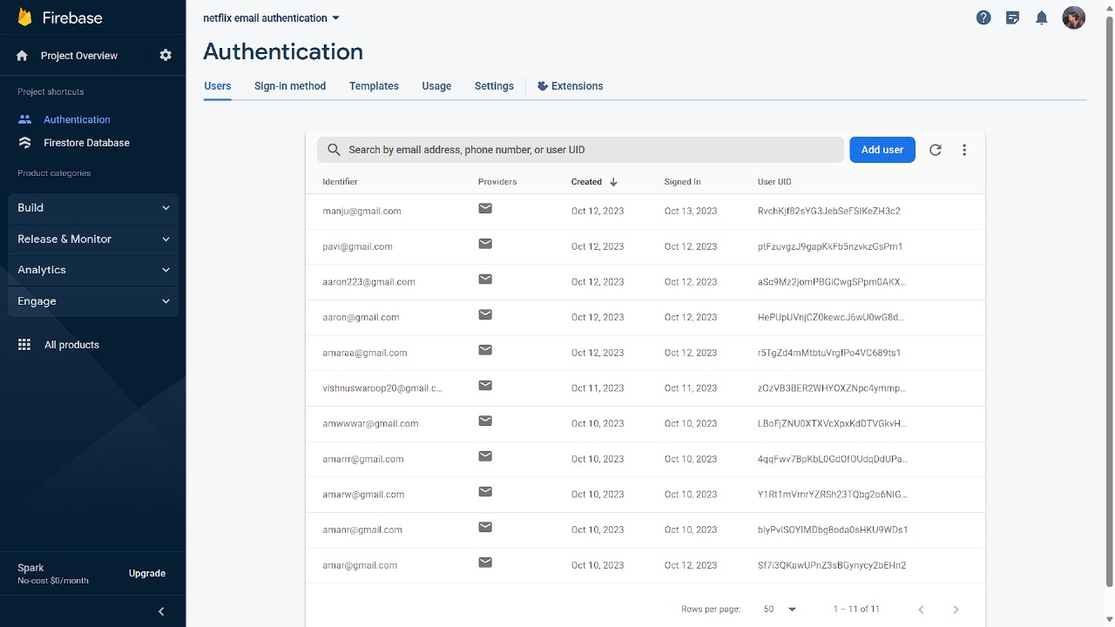

Slide 17
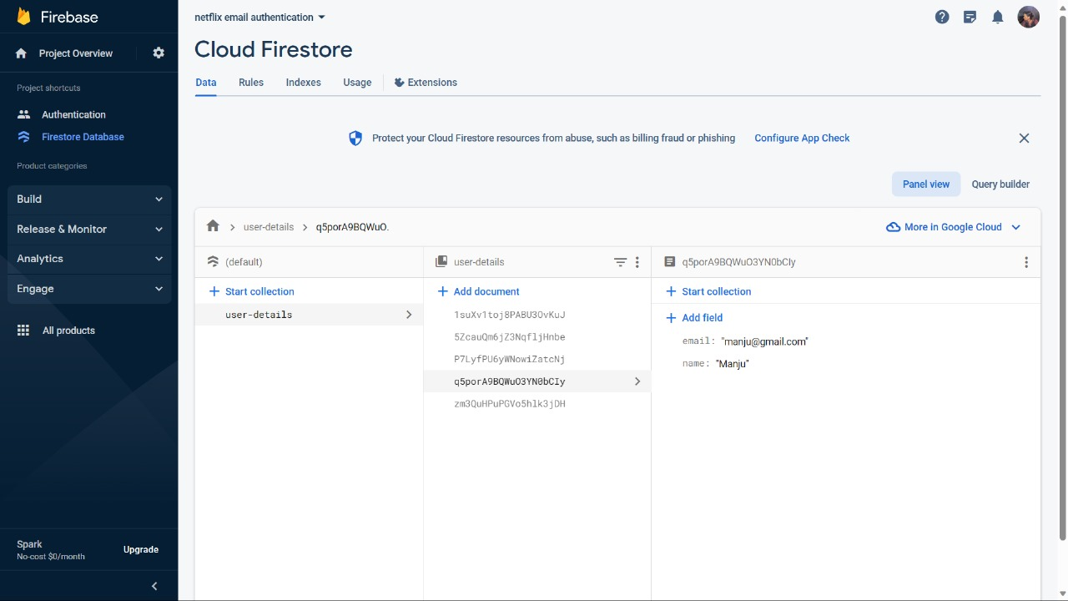

Slide 18
Thanks!

